Slide 1
Tuberculosis Infection – Pediatric Challenges
Vandana L. Madhavan, MD, MPH
Clinical Director,
Pediatric Infectious Disease
MassGeneral Hospital for Children
February 11, 2021

Slide 2
I have no relevant disclosures

Slide 3

Significance of Tuberculosis in Children
Personal Health: High rates of morbidity and mortality compared to adults
Public Health: Diagnosis of TB infection or disease in a child is considered a “sentinel public health event” usually representing recent transmission of TB

Slide 4
Risk of Progression to TB Disease
Immunocompetent adults
  5-10% lifetime risk of developing disease after infection
Adults with TB infection and untreated HIV infection
  5-10% annual risk of developing disease
Children and the risk of TB disease….

Slide 5
Risk of Progression to TB Disease by Age
Newton S, et al Lancet ID 2008 after Marais BJ, et al. Int J Tuberc Lung Dis 2004
Notes:
5
Note the very high risk of progression from TB Infection to disease in infants, and the risk of Miliary and meningeal TB in those less than 1 year old. The disease rates then dip representing the “safe school years” and then rise in adolescence though not as high as in infancy.
Although the risk is highest in children < 2 years old, we can not say that all will get sick. Active surveillance data from the pre-chemotherapy era suggest that most children developed radiological abnormalities following infection, including 60–80% of children under 2 years; however, less than 10% of these were notified, suggesting disease was controlled by the host immune response in most cases.

Slide 6
High-Risk Groups (Pediatrics)
Age groups:
  Infants and young children
  Post-pubertal adolescents
Recent infection:
  Highest risk in first 6 months after infection
  Remains high for 2 years
Recent immigration
Immunodeficiency:
  HIV infection, Hodgkin disease, lymphoma, diabetes mellitus, chronic renal failure, malnutrition
  Immunosuppressive drugs: prolonged or high-dose corticosteroid therapy, chemotherapy, tumor necrosis factor (TNF-alpha) antagonists

Slide 7
Screening tests

Slide 8
Interferon gamma release assays (IGRA):
Use in children
Children <2
  TST preferred
  IGRA acceptable BUT
    Positive IGRA likely indicates infection with M. tuberculosis but negative IGRA does not rule out it out
Children >2
  IGRA preferred
    Especially with history of BCG, low likelihood of follow-up visit for TST read
    TST acceptable

Slide 9
BCG Vaccine and Tuberculin Skin Testing
History of BCG is never a contraindication to TST
Interpretation of TST results in BCG recipients is the same as for people who have not received the vaccine
Difficult to distinguish between (+) TST caused by M. tuberculosis infection vs. other causes
  Reactivity does not occur in some children after BCG vaccination
  If BCG does cause a (+) TST, the reaction is generally negative by 5 years of age
  If child is from a high-burden country, (+) TST is almost always due to LTBI
Therefore, management of children with a history of BCG and a (+) TST includes:
  IGRA if >2 years of age
  Diagnostic evaluation including a chest radiograph
  Appropriate treatment

Slide 10
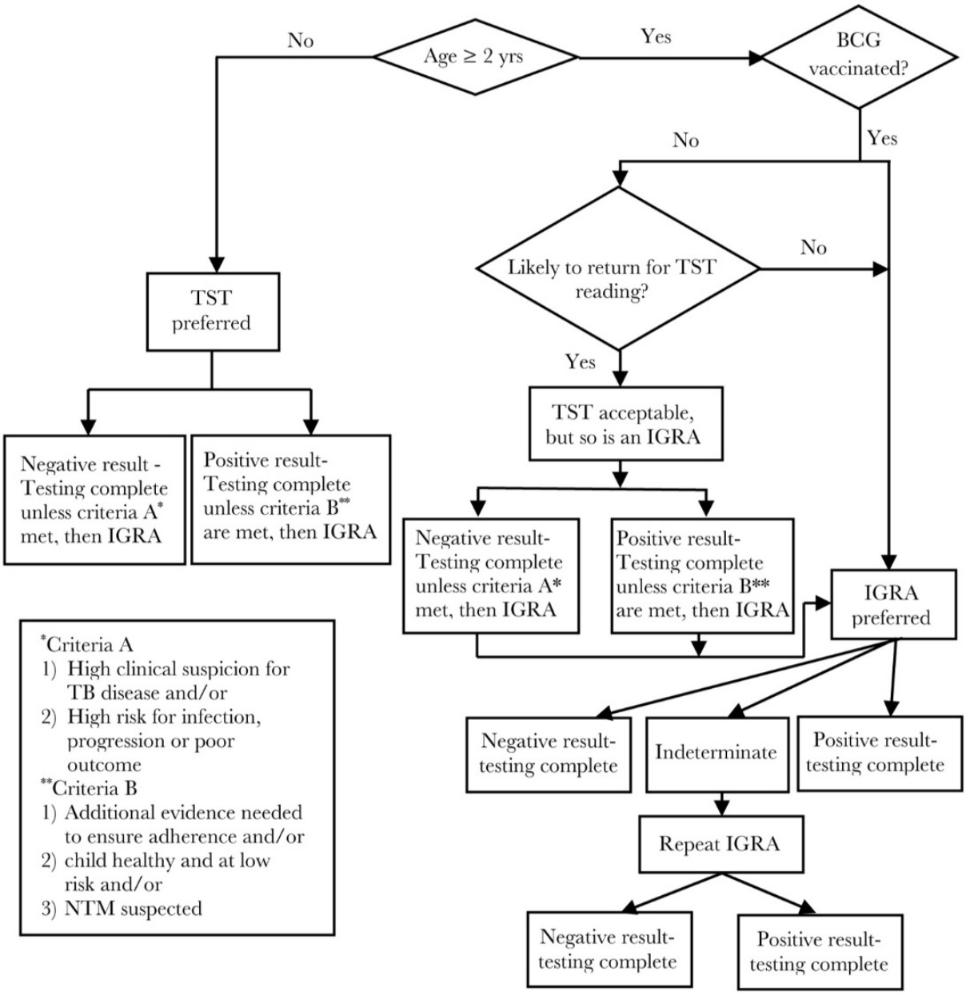
Guidance on strategy for use of TST and IGRA for diagnosis of LTBI by age and BCG immunization status
– AAP Red Book, 2018

Slide 11
Positive Screening Test: What Next?

Slide 12
Evaluation of child with TST or
IGRA positivity
Evaluation of all children with a positive TB test should include:
  Symptom analysis
    Remember infants/young children may not have “classic” symptoms
  Physical examination
  Chest radiographs (PA & lateral preferred, not portable AP)
  Household investigation

Slide 13
Imaging Pearls
PA/lateral CXR
  Children <5
  Symptomatic
  Household contact
  Previously concerning portable or single-view
  Any other concerns
Low threshold for low-dose chest CT
  Need contrast for lymphadenopathy
  Better for subtle findings
  Younger children without microbiology data – imaging may be only concrete information to follow

Slide 14
Treatment – TB infection

Slide 15
Summary of TB Infection Recommendations
Name | Medication(s) | Details
9H | Isoniazid QD x 9 months | May need B6
4R | Rifampin QD x 4 months | Counseling re: other Rx
3HP | Isoniazid/Rifapentine QW x 3 months (12 weeks) | Weekly DOT, higher doses
Isoniazid has historically been first-line medication choice in children
Rifampin increasingly used given equivalent efficacy
2018 Red Book lists recommendations for pediatric TB infection:
  3HP
  4R
  9H
Alternative regimens are recommended by AAP/CDC for patients who are
not able to tolerate above regimens

Slide 16
Treatment of TB Infection
12 weeks of isoniazid (15 mg/kg, max. 900mg) + rifapentine
  10.0–14.0 kg - 300 mg
  14.1–25.0 kg - 450 mg
  25.1–32.0 kg - 600 mg
  32.1–49.9 kg - 750 mg
  ≥50.0 kg - 900 mg maximum
Recommended as option for >5 years (“most experts”)
  Pros: Done in 12 weeks, no home Rx
  Cons: Need to adhere to weekly visits w/in 24-hour window, increased side effects
  Role for telemedicine? Need to make sure medications delivered, etc/
Children 2-5 years of age
  Increasing CDC safety and efficacy data to support use (“some experts”)
Children <2 years of age
  Not recommended - lack of safety and pharmacokinetic data

Slide 17
Treatment of TB Infection
Rifampin 15-20 mg/kg (max. 600 mg) PO daily for 4 months
  4-month course ~ 9-month course of INH (Cruz & Starke, IJTLD 2014)
  INH not tolerated
  Index patient isolate INH-resistant
  Counseling re: tears/urine, increased/decreased metabolism of other medications (esp. OCP)
  Nitrosamine contamination*
  Capsules (150mg and 300mg) – can be opened and mixed with small amount of (non-dairy) food/liquid – juice, honey (if >1), jam/jelly, non-dairy pudding, chocolate syrup (great for masking bitter tastes)
  Suspension – can stain teeth (try straw if old enough), needs to be refilled every 3 weeks
  Night-time administration to minimize nausea
Notes:
17

Slide 18
Nitrosamines
FDA recently notified providers about discovery of excess nitrosamine impurities in rifampin and rifapentine
  Common compounds found in many foods and beverages…with carcinogenic potential
  Risk is believed to be extremely low, requiring long-term exposure
In order to maintain the supply of these drugs for treatment of TB disease, FDA raised the maximum acceptable limits for these contaminants in these drugs
  31x for rifampin, 200x for rifapentine*
National TB Controllers Association (NTCA) and CDC are in dialog with FDA and manufacturers
  * 10/2020

Slide 19
Nitrosamines and Rifamycins:
Recommendations (MDPH*)
Treatment of latent TB infection:
  Currently receiving rifampin or rifapentine: continue this treatment, although a change to isoniazid (INH) is acceptable if preferred by the patient/family
  Newly diagnosed LTBI: Until more information becomes available, consider alternative treatment strategies in discussion with the patient/family
Treatment of TB disease:
  Continue use of rifampin if acceptable to the patient, as the risk of not taking rifampin likely outweighs any potential risk from nitrosamine impurities
* 12/2020

Slide 20
Treatment of TB Infection
INH 10-15 (20) mg/kg (max. 300 mg) PO daily for 270 doses
  Efficacy approaches 100%
  Adherence low (<75%)
  Alternative: Twice-weekly directly observed (DOT) INH 20-40 mg/kg (max. 900 mg) PO for 72 doses
Counseling re: avoidance of acetaminophen and alcohol, side effects/toxicity (mostly minor)
Pyridoxine supplementation for breastfeeding infants, malnutrition, (picky toddlers), pregnancy
Tablets (100mg and 300mg) can be crushed and mixed with small amount of breast milk, formula, milk, food (similar suggestions to RIF but can be dairy)
Suspension contains sorbitol and can cause diarrhea
Night-time administration to minimize nausea

Slide 21
Treatment of TB Infection
Monitoring while on isoniazid (or rifampin) monotherapy:
  Isolate sensitivities from contact (if available)
  Monthly assessment for clinical evidence of hepatotoxicity malaise, loss of appetite/weight, nausea, vomiting, abdominal pain, jaundice
  No baseline/routine LFTs unless:
    Concurrent liver disease
    Concurrent use of hepatotoxic medications
    Clinical evidence of hepatotoxicity
    Pregnancy or first 12 weeks postpartum

Slide 22
Other considerations

Slide 23
“Window Prophylaxis”
Children who are household/close contacts of known/suspected TB cases
  Symptom analysis, PE, TST (or IGRA)
  PLUS CXR (2 views) regardless of TST/IGRA result
If also <4 years of age AND
asymptomatic/NL PE/ negative TST (<5mm) OR
negative IGRA/NL CXR
    START isoniazid (or rifampin)
      Child may already be infected
      Infection more likely to progress to disease
      Infants and younger children are more likely to develop disseminated disease or meningitis
Notes:
HOW DO YOU MANAGE THE TB-EXPOSED CHILD….
PE – as many as 1/3 may have extrapulmoanry disease
CONTACT WITH HEALTH DEPARTMENT….INDEX PT. ISOLATE SNSITIVE TO INH? RESPONDING TO TREATMENT, LTFU?…FIGURE OUT WHEN TO REPEAT TST IF INITIAL ONE NEGATIVE

Slide 24
“Window Prophylaxis”
TST/IGRA repeated 8-10 weeks after last known/suspected contact with index case
  If TST/IGRA (-), discontinue INH [or RIF]
  If TST/IGRA (+), re-evaluate child and treat accordingly
  Exceptions: neonates
    TST likely not reliable until 4-6 months
    Could continue RIF x 4 full months or INH x full 9 months, if concerned enough

Slide 25
Pregnancy (from a pediatric perspective)
All four first-line medications (rifampin, isoniazid, pyrazinamide, ethambutol) are considered safe in pregnancy
Routine monitoring (e.g., LFTs) recommended
Pyridoxine supplementation recommended

Slide 26
Breastfeeding
Postpartum women should NOT delay treatment for TB infection
  Higher risk of progression to disease in both pregnancy AND postpartum period
  Neonates/young infants at both higher risk of infection acquisition AND progression to (disseminated) disease
  Isoniazid not contraindicated
    Amount in breast milk very low (1.2% relative dose, below 10% threshold of concern)
    Isoniazid safe to give to neonates directly
    Neonates should receive pyridoxine if mother on isoniazid
  Rifampin also considered safe during lactation

Slide 27
Telemedicine
NSMC/Salem experience during COVID-19 pandemic –
  Deferral of new patients with negative CXR with advocacy for younger patients
  Phone or car visits for LTBI and some TB disease patients (e.g., COVID-positive parents, stable toxicity monitoring allowing increased interval)
  Advocacy for pediatric considerations (siblings, need to have parent regardless, etc.)
  Fewer LTBI referrals – kids are traveling less, school nurses are more focused on COVID
  Delayed diagnosis of active TB…?

Slide 28
Telemedicine
MGH Pediatric ID experience –
  VV for follow-up patients since December 2016
  Ramped up during pandemic (MD participation, patient volume, new consultations as well)
  LTBI initial evaluations and follow-up – some all virtual
    older children seen by PCP
    not part of contact investigation
    no need for laboratory monitoring
    no infants/toddlers needing weight-based dose adjustments
MGH Pediatric Hospital Medicine
  VV for complicated post-discharge coordination since June 2018
  Some visits with pharmacist to observe medication administration
Many potential roles in TB care
Madhavan, VL and El Saleeby, CM. So You Want to Start an Infectious Diseases Telemedicine Service? JPIDS. April 29 2020. https://doi.org/10.1093/jpids/piaa032
Madhavan, VL et al. Ensuring Quality Transitions of Care from the Hospital to the Home Setting by Utilizing Virtual Visits: A Novel Pilot Study. Meeting Abstract. Pediatrics. July 2020. https://doi.org/10.1542/peds.146.1_MeetingAbstract.234-a

Slide 29
Take-home points
TB cases are rising in the US – effect of pandemic?
  Pediatric TB case rates highest in infants and post-pubertal adolescents
Children are usually:
  Infected by adult/adolescent household contacts
  Not infectious (contagious)
Tuberculosis or LTBI in a child is a sentinel public health event
TB control in the United States:
  Targeted testing – TST vs. IGRA (latter now preferred down to age 2)
  Contact investigations
  Evaluation of TB-exposed child - TST/IGRA, CXR, “window prophylaxis”
  Importance of LTBI identification and treatment (changing Rx recommendations)
Always have a high index of suspicion for TB in children – diagnostic challenges
Medication challenges in children and importance of DOT for active cases
Role of telemedicine

Slide 30
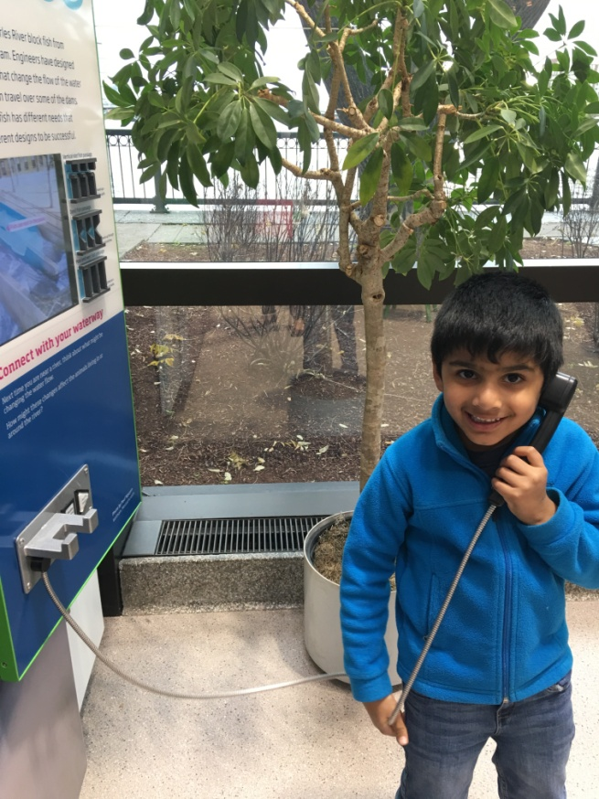
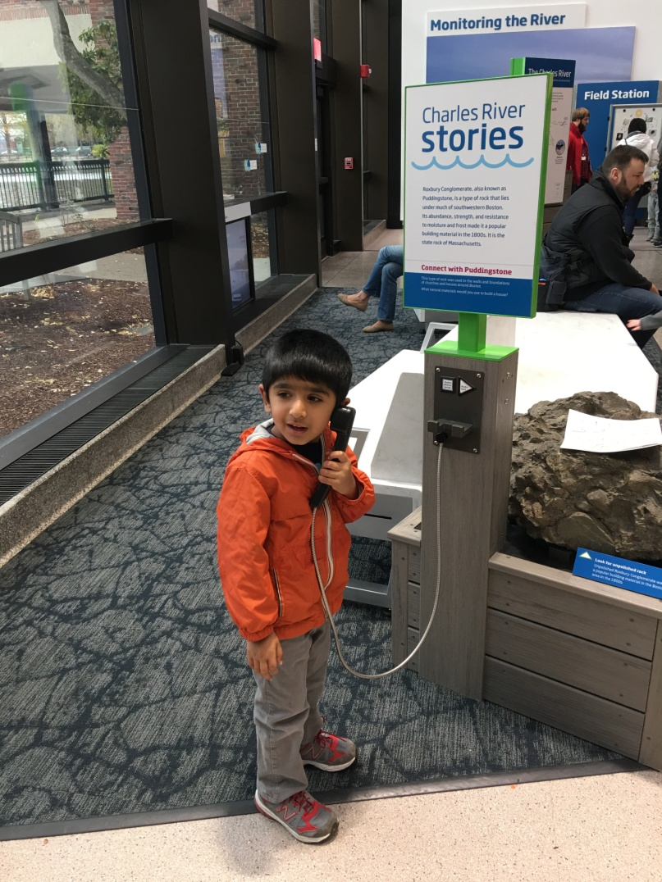
Thank you –
Questions? vmadhavan@mgh.harvard.edu

