Slide 1
MA LTBI ECHO – TB Infection in Pregnancy
October 14, 2021
Daria Szkwarko, DO, MPH

Slide 2
The LTBI Care Cascade
Step 1: Identification
High-Risk individuals need to be identified
Step 2:
LTBI Screening
High-Risk individuals undergo LTBI screening
Step 3:
Active TB Evaluation
Individuals who test positive for LTBI undergo active TB evaluation with symptom screen and chest x-ray
Step 4:
LTBI treatment initiation
Individuals who do not have active TB disease are started on LTBI treatment
Step 5: LTBI treatment completion
Individuals started on LTBI treatment need to follow up monthly and complete therapy
Notes:
Does this look different in pregnancy?

Slide 3
TB Case Rates by Age and Sex,
United States
US CDC TB Report, 2016

Slide 4
TB incidence peaks in women of reproductive age…
US CDC TB Report, 2016

Slide 5

Risk of pregnancy complications vs. no TB
Maternal complications
  Pre-eclampsia & eclampsia (2 fold)
  Vaginal bleeding (2 fold)
  Hospitalization (12 fold)
  Miscarriage (10 fold)
Jana Int J Gyn Obstet 1994
Jana NEJM 1999
Chin HC BJOG 2010
Bjerkedal 1975
Bothamley 2001
Pillay Lancet ID 2000;
Mathad CID 2012

Slide 6
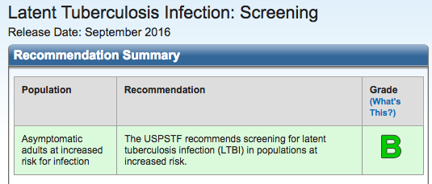
TB Infection Screening in Pregnancy
Notes:
It’s the same! ACOG and CDC agree that at risk women should be screened. Some hospitals do screen all women -

Slide 7
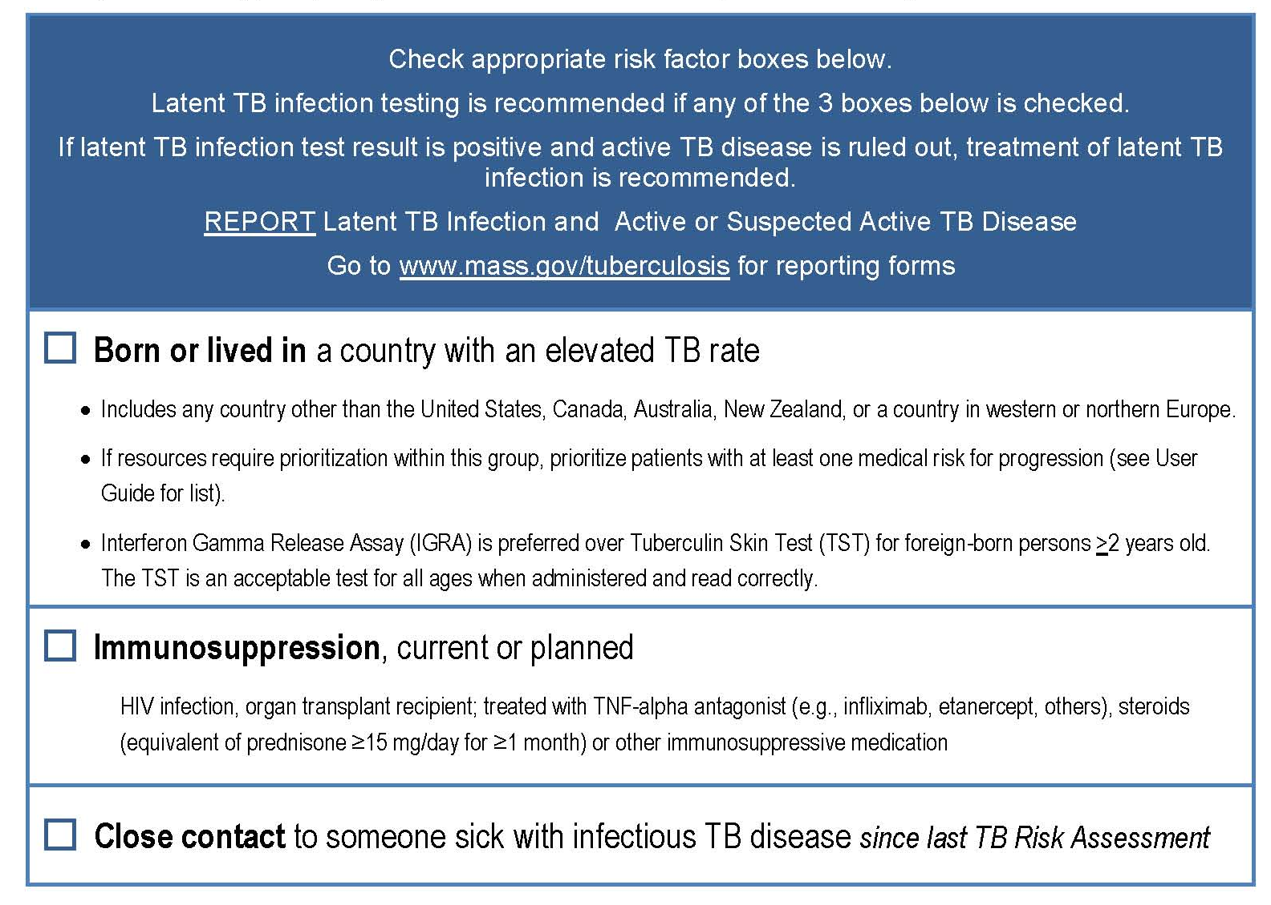

Slide 8
Ruling out TB disease in pregnancy
Symptom screen
Shielded chest x-ray: single view PA

Slide 9
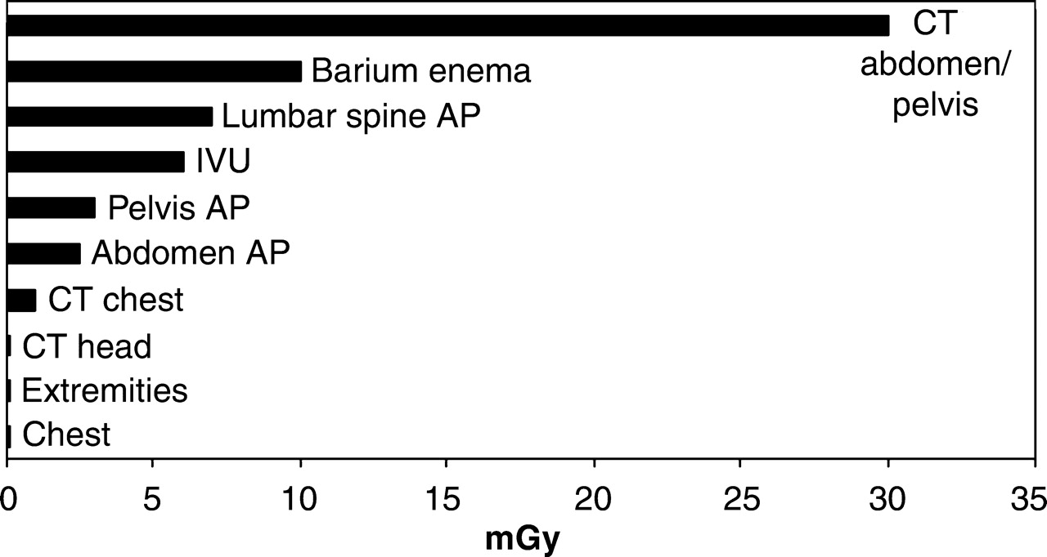
Shielded chest Xray is safe in pregnancy
ACOG²
  Xray exposure <5 rad (50 mGy) not associated with pregnancy loss or fetal anomalies
  Ultrasound and MRI are not associated with known adverse fetal effects
Comparison of the estimated mean fetal absorbed dose from radiographic procedures¹
¹Patel, Radiographics 2007; ²ACOG, Obstet Gynecol 2004

Slide 10
Treatment of latent TB in pregnancy
 | Recommendations
HIV negative | Defer until 3 months postpartum, unless… recent household contact recent new conversion – within 2 years ***rarely if high risk to drop out of care postpartum - call your local ID doc, TB clinic, DPH for guidance
HIV positive | INH 300mg + Vit B6 (10-25mg) daily for 9 mos^{1,2}
¹CDC 2013, ²WHO 2010

Slide 11
Treatment in pregnancy - Regimens
Nine months of INH (add B6)
Four months of rifampin
12 weeks of weight-based INH/RIF (3HR)
  Please note that 3HP is not recommended
**Patients who become pregnant while on treatment should continue treatment (but need to change regimen to a preferred regimen for pregnancy)

Slide 12
Treatment Monitoring in Pregnancy
Baseline and monthly LFT monitoring!

Slide 13
Breastfeeding and INH
According to lactmed…
  Recommend B6 with INH to all nursing parents
  Low levels of INH in breast milk, but monitor infants for rare instances of jaundice and have parents bring baby in immediately if jaundice occurs
  Encourage breastfeeding parent to take INH before infant’s longest sleep period which will decrease levels of INH dose that infant receives.
  Breastfeeding infants should receive B6 (however most multi-vitamin formulations contain enough!)

Slide 14
Breastfeeding and Rifampin
Low levels of rifampin may occur in breastmilk but are not expected to cause any adverse effects in breastfed infants.
Breast milk may be stained orange

Slide 15
Frequently Asked Questions – Case 1
A 30yo G4P3003 at 8’4wks presents for prenatal care. She is new to your practice and is a refugee originally from the Democratic Republic of Congo and lived on a refugee camp in Kenya for 10 years prior to coming to the US 6 months ago. She was resettled in Virginia and tells you she had a positive TB test but moved before ever getting treated. You get her records and she had a positive IGRA 4 months ago and a negative chest xray later that month. She has no other medical problems and her other intake labs were normal.
  How do you proceed?
Notes:
There isn’t really great guidance on this so we have worked with the Mass dept of public health and ID to make our own algorithm. In this very common scenario, we defer getting a chest xray until third trimester to ensure no active TB disease. At UMass if you don’t get the chest xray, mom is taken to get one immediately after delivery.

Slide 16
What is your practice pregnant individuals with positive LTBI test and negative chest x-ray before pregnancy?
Notes:
There isn’t really great guidance on this so we have worked with the Mass dept of public health and ID to make our own algorithm. In this very common scenario, we defer getting a chest xray until third trimester to ensure no active TB disease. At UMass if you don’t get the chest xray, mom is taken to get one immediately after delivery.

Slide 17
Frequently Asked Questions – Case 2
A 22yo G2 now P2 s/p NSVD at term 5 months ago. She had a positive IGRA at her first prenatal visit and since she was healthy, not a recent contact and never had a previous TB test, you appropriately waited until postpartum to treat her. Baseline LFTs were normal at 3 months and she was started on INH and B6 (this was her preference over rifampin because she wanted a Nexplanon for birth control). Repeat LFTs one day ago are 2x the upper limit of normal.
  What do you do?

Slide 18
A reminder about elevated LFTs with INH
If following LFTs....
  stop treatment if LFTs >3 times upper limit + symptoms OR if LFTs >5 times upper limit + no symptoms

