Slide 1

Management of Co-Occurring Conditions: HIV, HBV, SUD
MA Hepatitis C ECHO
Emily Min, MD, AAHIVS
Dept of Family Medicine and Community Health, UMass Chan Medical School
Family Health Center of Worcester, Worcester, MA
11/7/2025
Notes:
No financial disclosures

Slide 2
Learning Objectives
Identify key considerations for HCV management in individuals with HIV or HBV coinfection
Discuss strategies to integrate harm reduction and medication-assisted treatment (MAT) into HCV care
Review the screening and management of other liver diseases in patients with HCV

Slide 3
Screening for coinfection
At time of HCV diagnosis:
  HIV screening:
    HIV 4th gen antigen/antibody
    Including HIV RNA testing if concern for acute HIV
  Hepatitis B screening:
    HBsAg – surface antigen
    HBsAb – surface antibody
    HBcAb – core antibody
  Hepatitis A screening:
    HAV antibody
Additional screening: substance use, sexual histories

Slide 4
HIV Coinfection: Epidemiology
5% of US adults with HCV have HIV coinfection
  Conversely, 6-30% of people with HIV (PWH) in the US have HCV coinfection, with wide variation based on specific risk factors
Routes of transmission for HCV and HIV are similar, though HCV is 10x more infectious percutaneously
Notes:
Bosh KA, Coyle JR, Hansen V, et al. HIV and viral hepatitis coinfection analysis using surveillance data from 15 US states and two cities. Epidemiol Infect. 2018;146:920-930.
Platt L, Easterbrook P, Gower E, et al. Prevalence and burden of HCV co-infection in people living with HIV: a global systematic review and meta-analysis. Lancet Infect Dis. 2016;16(7):797-808.

Slide 5
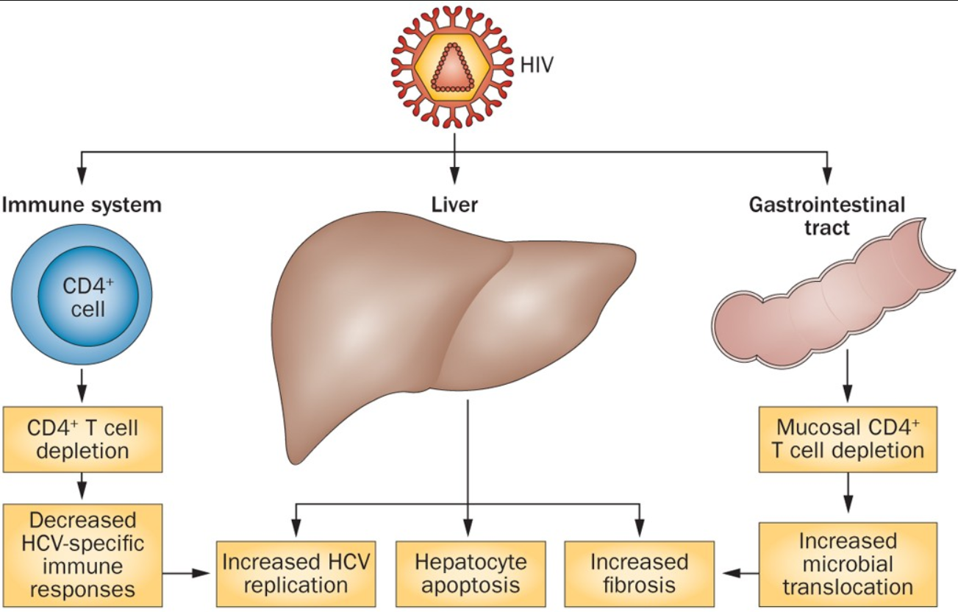
HIV Coinfection: Natural History
Image: Chen, Feeney, Chung. Nature 2014.
Notes:
Co-infection with HIV accelerates liver fibrosis via enhanced immune activation and increased oxidative stress in hepatocytes
HIV infection increases HCV replication, augments HCV-induced hepatic inflammation, increases hepatocyte apoptosis, increases microbial translocation from the gut and leads to an impairment of HCV-specific immune responses. Cirrhosis is estimated to develop decades (12-16 years) more prematurely in patients with HIV/HCV coinfection. Treatment of HIV with antiretroviral therapy and treatment of HCV have independently been shown to delay the progression of fibrosis and reduce complications from end-stage liver disease among co-infected patients.
https://pmc.ncbi.nlm.nih.gov/articles/PMC5939344/
https://pubmed.ncbi.nlm.nih.gov/36375129/

Slide 6
HIV Coinfection: a note on diagnosis
Immunosuppressed patients (including PWH with a CD4 count of <200 cells/mm³) may have false negative HCV antibody testing and should have testing repeated when their immune systems are reconstituted
Can also be screened with an HCV RNA test if a more immediate result is needed
  Typically detectable in patients within 1-2 weeks of infection
Periodic screening in PWH: annually in at-risk individuals ie MSM, trans women, and PWID
Notes:
False-negative anti-HCV antibody results are possible among people with HIV but uncommon (2% to 4%), and more likely to be seen in patients with advanced immunosuppression⁶¹ (CD4 cell count <200 cells/ mm³).

Slide 7
HIV Coinfection: treatment considerations
With current direct-acting antivirals: sustained virologic response (SVR) rates are comparable between patients with coinfection and those with HCV monoinfection
Studies show that PWH do not necessarily need additional follow-up in the course of HCV treatment to reach strong outcomes
  MINMON: Of the 400 participants, 399 initiated sofosbuvir/velpatasvir treatment. At entry, 166 (42%) were living with HIV, and 94.6% achieved SVR, similar to those without HIV (95.3%)
  EXPEDITION-2: pan-genotype + HIV coinfection – treated with glecaprevir-pibrentasvir
    No cirrhosis: 8 weeks; compensated cirrhosis: 12 weeks
    Most common ART regimens: dolutegravir, raltegravir, rilpivirine-anchored
    SVR12: 98%
Notes:
This open-label, dual-arm, phase 3 trial enrolled adults with HCV (genotype 1, 2, 3, 4, 5, or 6) and HIV coinfection to receive HCV treatment with glecaprevir-pibrentasvir. The 137 participants without cirrhosis were assigned 8 weeks of HCV treatment, and the 16 individuals with compensated cirrhosis received 12 weeks.^{[22]} Most participants (63%) had HCV genotype 1, and 18% were treatment-experienced (16% previously treated with an interferon-based regimen and 2% with a sofosbuvir-based regimen).^{[22]} All but 10 participants were taking raltegravir, dolutegravir, or rilpivirine as the antiretroviral therapy anchor drug. The overall SVR12 rate was 98% (150 of 153); one individual with HCV genotype 3 and cirrhosis experienced on-treatment HCV virologic breakthrough
Initially thought to be treatment-refractory in interferon era
Do not necessarily need extra f/u due to HIV status (SMART-C)
Solomon SS, Wagner-Cardoso S, Smeaton L, et al. A minimal monitoring approach for the treatment of hepatitis C virus infection (ACTG A5360 [MINMON]): a phase 4, open-label, single-arm trial. Lancet Gastroenterol Hepatol. 2022.
Rockstroh JK, Lacombe K, Viani RM, et al. Efficacy and Safety of Glecaprevir/Pibrentasvir in Patients Coinfected With Hepatitis C Virus and Human Immunodeficiency Virus Type 1: The EXPEDITION-2 Study. Clin Infect Dis. 2018;67:1010-17.

Slide 8
HIV Coinfection: treatment considerations
HIV: not excluded from “simplified treatment criteria” per AASLD guidelines (for treatment-naïve persons +/- compensated cirrhosis)
Main considerations:
  Drug-drug interactions
  Possible effect on treatment duration
  Hepatitis B status

Slide 9
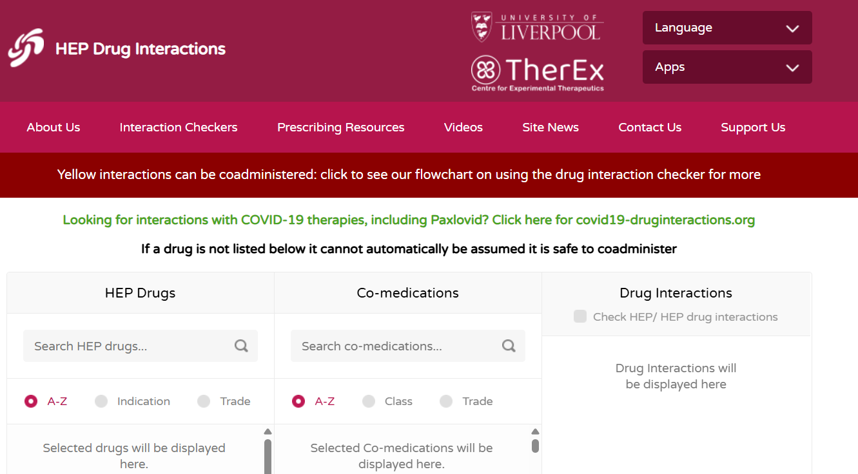
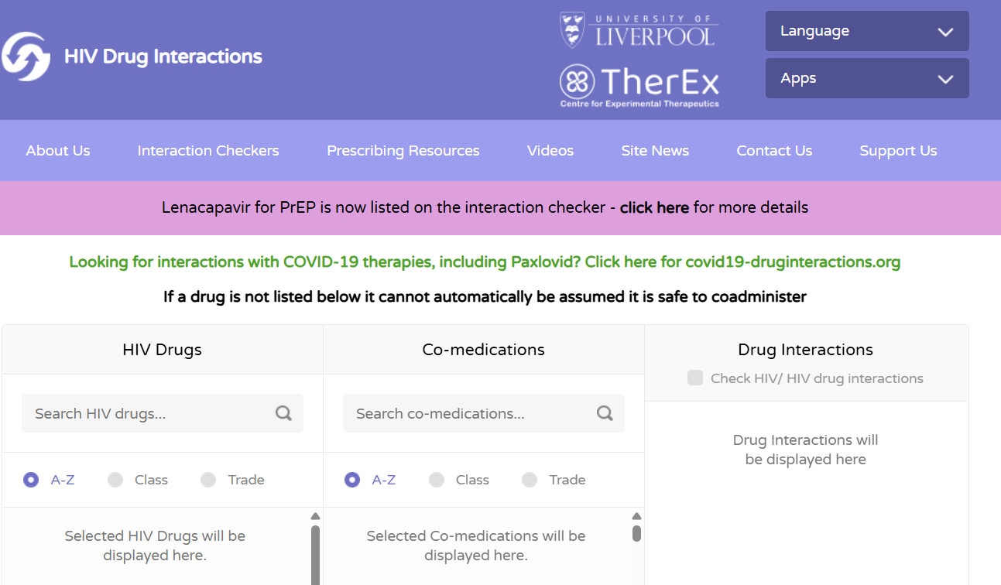
HIV Coinfection: drug-drug interactions
Liverpool Hep Drug Interactions (also: Liverpool HIV Drug Interactions)
  https://www.hep-druginteractions.org/checker
  https://www.hiv-druginteractions.org/checker

Slide 10
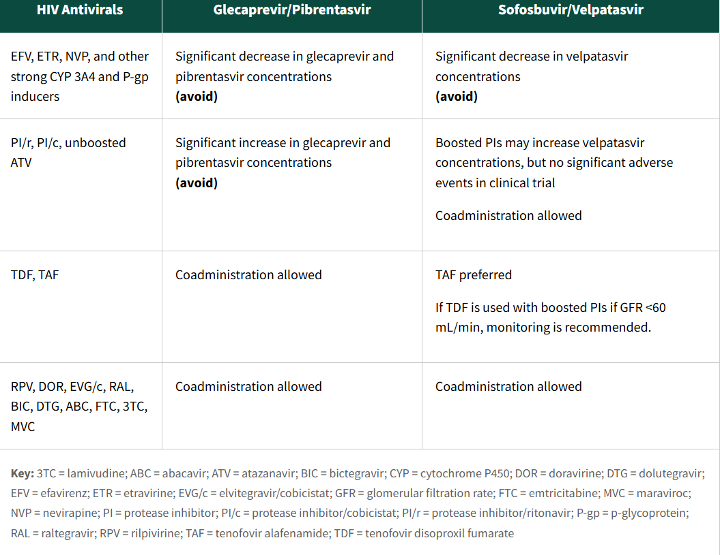
HIV Coinfection: drug-drug interactions
Source: DHHS Opportunistic Infections
Notes:
DDI less of a concern in the age of modern ART (losing the boosters)

Slide 11
HIV Coinfection: treatment recommendations
Treatment-naïve, without cirrhosis (AI):
  Glecaprevir-pibrentasvir (100-40) x 8 weeks (3 tablets daily)
  Sofosbuvir-velpatasvir (400-100) x 12 weeks (1 tablet daily)
  Note: If choosing ledipasvir-sofosbuvir (uncommon) in a treatment-naïve patient with genotype 1a/b (no cirrhosis): duration extended to 12 weeks (instead of standard 8 weeks for monoinfection)
Treatment-naïve, with compensated cirrhosis: same as recommended for HIV-negative persons
  Glecaprevir-pibrentasvir: no change compared to above
  Sofosbuvir-velpatasvir: x 12 weeks, if genotype 3: check for negative NS5A RAS Y93H
Notes:
Harvoni not common, not an A1 recommendations for DHHS (HIV guidelines)

Slide 12
HIV Coinfection: exclusions to simplified treatment
History of previous HCV treatment (resistance/incomplete response; not reinfection)
Decompensated cirrhosis
ART:
  Efavirenz, etravirine, nevirapine, boosted protease inhibitors
  TDF: if eGFR <60 mL/min
Untreated chronic HBV
Pregnancy
Notes:
Given these considerations, sofosbuvir/velpatasvir can be co-administered with boosted ARV regimens (AII); TAF-based regimens are preferred. People on TDF-containing boosted ARV regimens are not eligible for simplified HCV treatment if their estimated glomerular filtration rate is <60 mL/min because monitoring on treatment is recommended (AII).

Slide 13
HIV Coinfection: treatment considerations
May be treated simultaneously for both HIV and hep C
  Should be aware of hepatitis B status, and ensure patient is on antiretroviral therapy with anti-hep B activity if applicable before starting HCV antivirals
Increased risk of AST/ALT elevation after initiating ART:
  Recheck 4-8 weeks after initiation of ART
Notes:
HCV DAA therapy should not be withheld solely due to perceived lack of adherence with HIV therapy or untreated HIV infection (BIII)

Slide 14
Hepatitis B Coinfection
Epidemiology of coinfection
  Worldwide: estimated to be 1-15%
  US: ~1.4%
Implications
  HBV monoinfection: leading cause of chronic liver disease and hepatocellular carcinoma around the world
  NHANES: minority of people with chronic HBV are aware (33.9%)
  Increased risk of progressive liver disease → cirrhosis
Triple-screening: HBsAg, HBsAb, HBcAb
Notes:
Due to co-occurring modes of transmission, higher rates of HBV infection have been reported in persons infected with hepatitis C virus (HCV), likely due to overlapping risk factors for acquisition of these two hepatitis viruses.^{[40]} In a National Veterans Affairs cohort of persons infected with HCV, the prevalence of HBV coinfection was 1.4%. In this same cohort, the prevalence of prior or current HBV infection was 36.6%
Holmes JA, Yu ML, Chung RT. Hepatitis B reactivation during or after direct acting antiviral therapy - implication for susceptible individuals. Expert Opin Drug Saf. 2017;16:651–672. doi: 10.1080/14740338.2017.1325869.

Slide 15
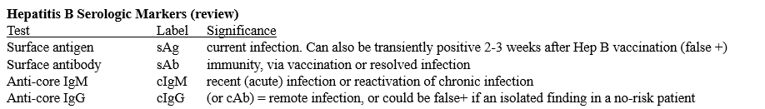
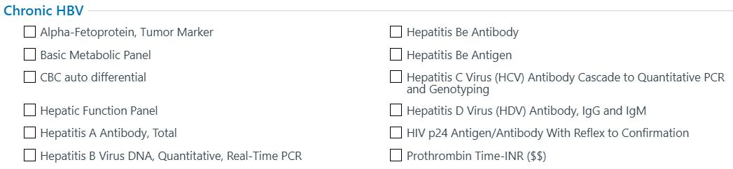
Hepatitis B Coinfection: diagnosis

Slide 16
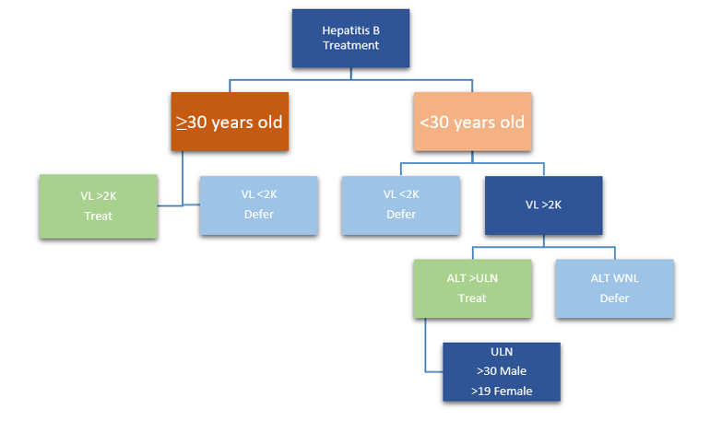
Hepatitis B Coinfection: treatment guidelines
Image adapted from Dieterich et al. GH Advances 2023.
Notes:
https://www.ghadvances.org/article/S2772-5723(22)00170-4/fulltext#gr1
In January 2021, an expert panel convened to discuss a simplified algorithm for HBV management, which is shown below. The impetus for this meeting was the high number of chronic hep B patients who did not meet guideline-directed treatment recommendations, creating a population of chronic HBV patients intended to undergo regular monitoring for eventual treatment eligibility but who often were not well-engaged in and/or fell out of care. While this position not been formally adopted by any professional societies, there are compelling reasons to follow their simplified guidelines. They expand the number of people eligible for HBV treatment, reducing the risk of disease progression, cirrhosis and HCC compared to more conservative treatment recommendations. Additionally, simplifying HBV treatment and monitoring criteria is intended to increase the comfort of non-specialists to prescribe treatment. This will increase access to HBV care, as many people at higher risk for HBV infection may not have rapid access to specialists.

Slide 17
Hepatitis B Coinfection: treatment considerations
Risk of HBV reactivation with initiation of HCV direct-acting antivirals: ~12% risk in people with positive Hep B sAg
AASLD:
  Start HBV antiviral therapy at the same time as DAA therapy if:
    Cirrhosis
    Meet guidelines for HBV treatment
  If guidelines for HBV treatment not met:
    Check HBV DNA every 4-8 weeks while on HCV treatment, and for 3 months after HCV treatment
Can consider empirically treating any person with positive hep B surface antigen for chronic HBV at time of HCV treatment
Notes:
Recommend pre-treatment of HBV prior to HCV in HBV/HCV co-infected persons should be considered in consultation with a clinician with HBV treatment expertise.
+cAb, negative sAg: risk of HBV reactivation is rare with HCV treatment: can be monitored with ALT levels at baseline, at the end of HCV treatment, and at post-treatment follow-up.
if an HCV/HIV co-infected person is also found to have had prior HBV exposure (+core antibody) or chronic HBV infection (+surface antigen), HIV antiretroviral therapy with activity against HBV should be initiated before starting HCV treatment

Slide 18
Hepatitis B Coinfection: treatment recommendations
Oral antiviral medications available
  Most common: nucleotide analogues
First line:
  Tenofovir DF, tenofovir AF
  Entecavir

Slide 19
Substance use disorder
While achieving an SVR is a cure, it does not provide immunity, and reinfection is possible
  Interdisciplinary teamwork plays a SIGNIFICANT role in the treatment of comorbid polysubstance use to reduce the risk of reinfection!
Treating HCV reduces community infection risk by preventing transmission network growth
  Offers opportunity to engage in care
Considerations:
  Mental health screening
  Chemsex as a risk factor
Notes:
Integrated primary care/counseling services (such as at CHCs!)

Slide 20
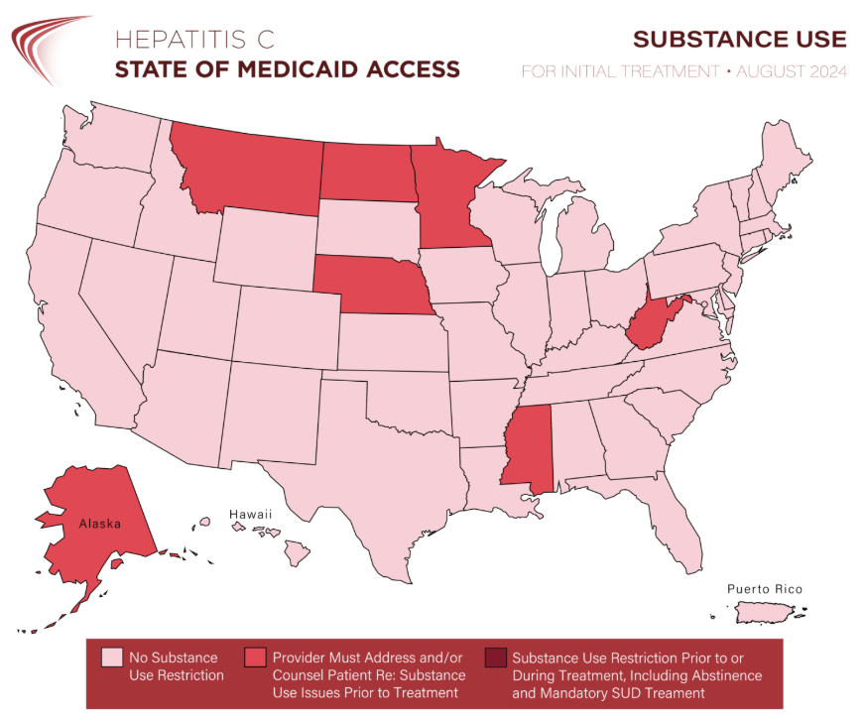
Substance use disorder
Active substance use: NOT a contraindication for HCV treatment
  Abstinence from substances has not been shown to have an effect on SVR rates

Slide 21
Integrating harm reduction/MAT into HCV care
Co-location of services
  ANCHOR: DC-based harm reduction organization drop-in clinic data: treated patients with chronic HCV and active IDU with DAA (sofosbuvir-velpatasvir) and offered buprenorphine-naloxone at intake
    82% achieved SVR: significant association with 2+ months of DAA and receiving MAT by week 24
Peer support availability: including to encourage HCV screening
Directly-observed therapy to enhance adherence to treatment
Inter-agency collaboration (ie with local mobile health, testing services, syringe service programs)
No known drug-drug interactions between glecaprevir-pibrentasvir and sofosbuvir-velpatasvir and MAT regimens, including for opioid, alcohol, and stimulant use disorder
Notes:
https://pmc.ncbi.nlm.nih.gov/articles/PMC7755091/
https://pmc.ncbi.nlm.nih.gov/articles/PMC9005784/

Slide 22
MASLD
Metabolic-associated steatotic liver disease: now the most common cause of chronic liver disease globally
  Excess adipose storage in hepatocytes increases inflammation, which can be compounded by chronic HCV infection
Chronic HCV infection also stimulates hepatic steatosis
Diagnosis of obesity prior to DAA treatment: negative association with fibrosis improvement at 1-year follow-up
MASH: metabolic-associated steatohepatitis→ advanced MASLD with fibrosis/scarring and inflammation
Notes:
https://pmc.ncbi.nlm.nih.gov/articles/PMC11587073/
McPhail J., Sims O.T., Guo Y., Wooten D., Herndon J.S., Massoud O.I. Fibrosis improvement in patients with HCV treated with direct-acting antivirals. Eur. J. Gastroenterol. Hepatol. 2021;33:996–1000.
The development of steatosis in patients with chronic HCV infection ranges between 40–86%, with an average of 55% in all genotypes.
having obesity before treatment with DAAs is negatively associated with improvement of fibrosis at 1-year follow-up

Slide 23
MASLD: diagnostic criteria
Hepatic steatosis on imaging
Elevated ALT and AST without alternative explanation
Presence of type 2 diabetes, or 2+ of the following metabolic risk factors:
  Obesity
  Prediabetes
  Hypertension
  Hyperlipidemia
First-degree relative with diagnosed cirrhosis 2/2 MASLD

Slide 24
MASLD: treatment considerations
Management of metabolic risk factors
Alcohol abstinence
Vaccination against hepatitis A and B
Weight loss with a goal of 5-7% weight loss
  Semaglutide: guideline-recommended for MASH with F2-3 fibrosis

Slide 25
Hepatitis A Virus
Risk factors for hep A and hep C overlap (ie, homelessness, IDU, MSM)
  While not found to cause chronic hep A infection, can become relapsing especially in immunocompromised
  70% of adults do develop symptomatic acute hepatitis
  Acute liver failure: rare, <1%, but more likely if other comorbid liver diseases present
Assess for immunity at time of intake with hep A antibody
  Vaccinate if non-immune
Notes:
The virus is transmitted fecal-orally and is most commonly spread via direct contact with an infected individual or ingestion of contaminated food or water; in the US, outbreaks have also been seen in nursing and group homes. Other risk factors for HAV infection include homelessness, injection drug use, sexual contact between men who have sex with men (MSM, specifically through digital- or oral-anal intercourse), international travel without documented immunity, or occupation-related risks

Slide 26
Takeaways
Co-occurring conditions, whether other bloodborne viruses or metabolic-related, increase the risk of existing liver damage associated with chronic hepatitis C infection
HIV/HCV coinfection: management of treatment-naïve patients without cirrhosis (or with compensated cirrhosis) is largely the same as for HCV infection alone – use resources (ie Liverpool) to assess for drug-drug interactions
HBV/HCV coinfection: risks of HBV reactivation exist with initiation of DAA’s – consider concurrently treating HBV
  And if a patient has known HIV/HBV/HCV infection, they must be on an HIV regimen with hepatitis B coverage before starting HCV treatment
The role of the interdisciplinary team (for management of comorbid HCV and substance use disorders) is evidence-based!
Utilize your local resources!!

Slide 27
Questions?

