Slide 1
Shorter Course Regimens for Treatment of LTBI
John Bernardo, MD
Boston University School of Medicine
Massachusetts Department of Public Health
December 17,2020

Slide 2
Objectives
Describe short course LTBI treatment regimens
Pros and cons: 4mos Rifampin vs 3HP
Strategies for implementation in primary care
3HP by DOT vs Self Administration
Conflicts: None to declare

Slide 3
Why Treat LTBI?
Prevents morbidity
  Especially young children
Prevents transmission
  Reduces case numbers
Prevents deaths
  TB diagnosis recognized or missed
It’s less complicated to treat than TB disease
  Maybe
TB elimination
  Prevention reduces reservoir of future cases

Slide 4

TB Elimination
Goal for 2010* = incidence of 1 per 1,000,000 for active cases
  Requires LTBI prevalence ≤ 1%**
* CDC: MMWR. 1989 Jan 13;38(1):1‐4
** Styblo K. Bull Int Union Tuberc Lung Dis. 65:49, 1990

Slide 5
TB Prevention
1965: ATS recommends treatment of LTBI in persons with previously untreated TB, TST converters, young children: INH daily x 12 mos
  Expanded in 1967 to include TST >10mm
1974: CDC-ATS guidelines for pre-treatment screening to decrease risk of hepatotoxicity
  35 year age limit established
1983: CDC recommends clinical and laboratory monitoring for persons >35 who require treatment
  Notes 6 mos INH also may confer a substantial degree of protection
1994: CDC-ATS recommend “6-12 months” daily INH as effective for treatment of LTBI
  6mos INH confers a ‘nearly comparable’ degree of protection
CDC: DTBE
Notes:
Early evidence comes from controlled trials involving tens of thousands of pts and persons at risk for TB.
1983: ALSO comments that 6mos INH evidence “… may confer a substantial degree of protection.”
1994: ‘good evidence that 6mos INH confers a nearly comparable degree of protection.’

Slide 6
TB Prevention
1998: CDC recommends 2 months Rifampin + Pyrazinamide for treatment of LTBI in HIV: 2RZ
2000: CDC-ATS issue updated guidelines:
  Targeted Testing and Treatment of LTBI*
    9 months daily INH preferred
    Options include 2RZ and 4 months Rif
2001: Caution urged with 2RZ because of hepatotoxicity**
2003: 2RZ not recommended***
* CDC: MMWR June 9, 2000:49 (No. RR-6)
** CDC: MMWR Aug 31, 2001:50 (34)
*** CDC MMWR Aug 8, 2003.52 (31)

Slide 7
TB Prevention
2011: CDC recommends 2 months of once-weekly INH + Rifapentine as equivalent to 12 months INH in select high risk groups*
2016: US Preventive Services Task Force recommends TB screening of high risk persons as an essential health benefit**
* CDC: MMWR Dec 9, 2011: 60 (48)
** https://www.uspreventiveservicestaskforce.org/Page/Document/UpdateSummaryFinal/latent-tuberculosis-infection-screening

Slide 8
Costs of Prevention
Costs
  Medications
  Nursing time, DOT
  Monitoring (clinical and laboratory)
    Time from work, travel
  Medication toxicity
  Stigma
Benefits
  Cases averted
  Secondary cases averted
    Benefits to public health
Effective regimen: Benefits > Costs

Slide 9
TABLE 3. Recommendations for regimens to treat latent tuberculosis infection
Priority rank* | Regimen | Recommendation (strong or conditional) | Evidence (high, moderate, low, or very low)
Preferred | 3 mos isoniazid plus rifapentine given once weekly (3HP) | Strong | Moderate
Preferred | 4 mos rifampin given daily (4R) | Strong | Moderate (HIV Negative)†
Preferred | 3 mos isoniazid plus rifampin given daily (3HR) | Conditional Conditional | Very low (HIV negative) Low (HIV positive)
Alternative | 6 mos isoniazid given daily (6H) | Strong§ Conditional | Moderate (HIV negative) Moderate (HIV positive)
Alternative | 9 mos isoniazid given daily (9H) | Conditional | Moderate
MMWR Recomm Rep 2020;69 (No. RR-1):1–11

Slide 10
Isoniazid
Cheap
Effective
Historical standard of care

Slide 11
Risk reduction from various durations of INH in patients with LTBI*
Group | 3 months | 6 months | 12 months
Overall | 21% | 65% | 75%
Completers | 31% | 69% | 93%
* n 27,830; Fibrotic CXR, 7 countries.
INH or placebo; 5yr active follow-up
Bull. WHO. 1982, 60(4): 555
Notes:
Fibrotic lesions on CXR, 7 European countries.
Reduction in cases over 5 yr f/u reported

Slide 12
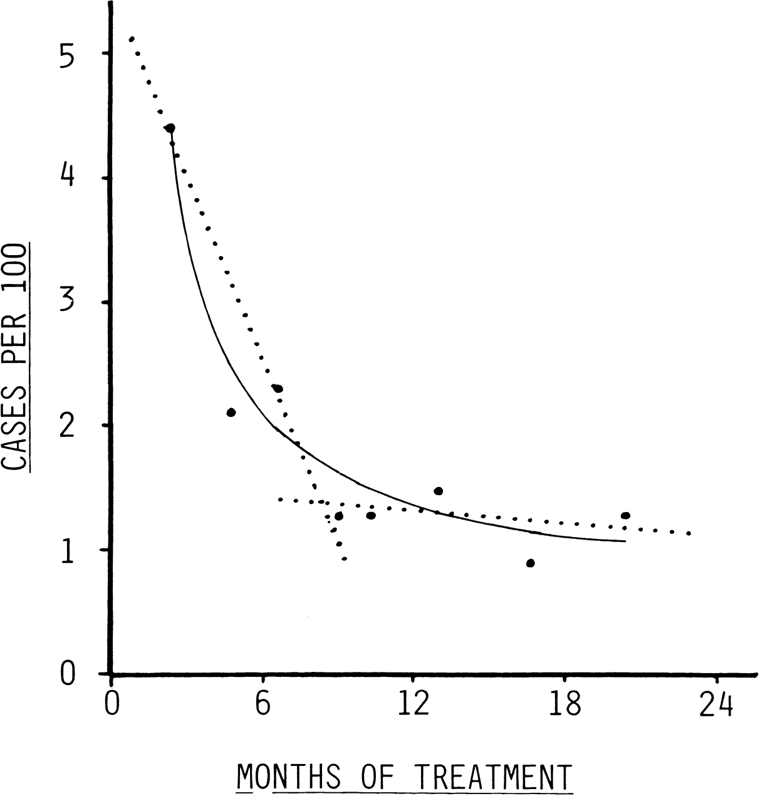
INH - How Long?
Comstock GW. Int J Tuberc Lung Dis. 1999 Oct;3(10):847‐50.
Notes:
Bethel Alaska USPHS studies 1957-59: households in 30 communities randomized to INH or placebo x 1yr. 13 yr f/u

Slide 13
INH: Major Issues
Length of treatment
  Poor adherence; <50% in some programs
Toxicity
  Requires at least monthly monitoring visits
INH resistance
  More than 9% of U.S. cases are INH resistant (2019)

Slide 14
Rifamycins
Rifampin, Rifabutin, Rifapentine
Inhibit DNA‐dependent RNA polymerase
  Active against non‐replicating bacteria
  Active against a broad array of bacteria
Much less hepatotoxicity than INH
However:
  Multiple drug interactions
  Other toxicities:
    “Hypersensitivity” syndrome
    Thrombocytopenia, anemia

Slide 15
Rifamycins
Some Drug Interactions
Oral anticoagulants Oral contraceptives
Cyclosporine Glucocorticoids
Itraconazole Ketoconazole
Methadone Midazolam or triazolam
Phenytoin Quinidine
Theophylline Verapamil
β‐Adrenergic blocking agents Chloramphenicol
Clarithromycin Dapsone
Diazepam Digoxin (oral)
Diltiazem Disopyramide
Doxycycline Fluconazole
Haloperidol Losartan potassium
Nifedipine Nortriptyline
Sulfonylureas Tacrolimus
Tocainide

Slide 16
Rifamycin
Hypersensitivity?
Refers to a variety of syndromes
  “Flu‐like” symptoms (fever, malaise, myalgias)
  GI upset (nausea)
  Dizziness, syncope
  Can be minor to severe
Most commonly seen with intermittent regimens
Mechanism(s) not understood
  May not be same for each drug or side effect
    Anti-rifampin antibodies found in patients with Rif-induced hemolytic anemia
    NO antibody found in CDC substudy of 3HP-induced syncope

Slide 18
Four Months of Rifampin or Nine Months of Isoniazid for Latent Tuberculosis in Adults
Open label, randomized trial
  6,859 patients, 9 countries
4 months Rifampin vs 9 months INH
28 month follow-up
Efficacy and safety
Principal findings:
  4 mos Rif was noninferior to 9 mos INH (8 vs 9 TB cases)
  Rate of completion better in Rif group (79 vs 62%)
  Toxicity (grade 3-5, esp hepatotoxicity ) was lower in Rif group
Menzies, et al. NEJM 379:440, 2018.

Slide 19
Rifapentine
Similar to rifampin; longer half‐life
  Similar drug interaction profile
Initially approved for once‐weekly therapy in the continuation phase of active TB
Few studies of efficacy for treatment of LTBI, once weekly in combination with INH
  1 study in children >2 y/o

Slide 20
3HP Evidence
Sterling, et al: TBTC Study 26 (NEJM 12/8/11)
  3HP (DOT) vs 9H (SAT)
  7,731 adults (>12y/o) with increased RISK:
    5,466 close contacts,
    1,925 TST converters,
    161 HIV-infected,
    179 with CXR changes c/w healed pulmonary TB
  Non-inferiority data analysis
    Low event rate; loss to follow-up
  3HP
    As effective as 9H (rate of TB appr. 50% that of 9H)
    Higher completion (82 vs 69%*)
    Higher permanent discontinuation for AE (4.9 vs 3.7%*)
    Higher incidence of “Hypersensitivity” (2.9 vs 0.4%*)
    Less hepatotoxicity (0.3 vs 2.0%*)
96%
* p < 0.01
Notes:
Final analysis of the data was less rigorous than the original study design due to several factors, including LOW EVENT RATES and LOSS TO FOLLOW-UP

Slide 21
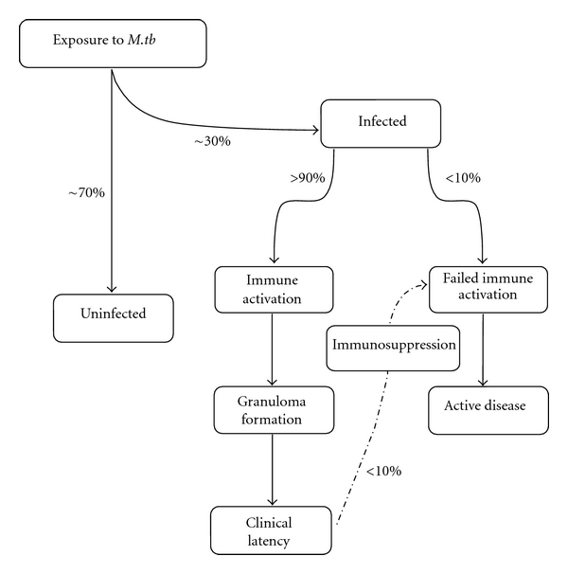
TB disease progression and major events leading to protection
x
time
“window”
x
time
Adapted from: Shaler, CR, et al. Clin Dev Immunol. 2012

Slide 22
3HP - Risks
Drug interactions
  Rifamycins interact with multiple drugs
    Articulated in Guidelines and Fact Sheet, with reference to major drugs (oral contraceptives, warfarin, sulfonureas, and methadone)
Adverse events
  Hepatotoxicity
    Less than 9H
  Pregnancy
  “Hypersensitivity”
    Includes “Flu-like syndrome”, nausea, light-headedness, syncope – usually following a 2nd or 3^{d} dose with prodrome following previous dose
Requires DOT: adherence AND safety
  HCW reviews symptoms following prior dose before next dose administration; if significant reaction is reported, dose is not given

Slide 23
3HP Safety Studies
7552 TBTC Study 26 subjects who received ≥1 dose of study drug*; 153 had SAE:
  138/3893 (3.5%) with 3HP vs 15/3659 (0.4%) with 9H (p < 0.001)
  3HP arm:
    87 (63%) had flu-like syndrome and 23 (17%) had cutaneous reactions
    13/3893 (0.3%) had severe reactions: 6 were hypotensive and 6 (0.15%) reported syncope
      Study did not account for held doses if subject reported symptoms following previous dose; likely underestimates significance of problem
Post marketing surveillance (CDC)
  Programs voluntary reporting SAE
  No denominator data
  No communication with FDA Medwatch Program
* Sterling, et al. Clin Infect Diseases 61:527, 2015

Slide 24
3HP: DOT?
TBTC Study 33: An evaluation of adherence to LTBI treatment with 12 doses of once weekly rifapentine and isoniazid given as self-administered versus directly-observed therapy: iAdhere*
  Compared SAT with DOT and “reminder” SAT; 4 countries
    SAT non-inferior to DOT for completion in US cohort only
    NOT powered for safety analysis, but says “similarly safe”
For now, safety concerns may preclude SAT for 3HP
  Especially pre-syncope/syncope
  Guidance statement from CDC is suggests SAT is acceptable (most patients)
*Belknap, R., et al. Annals Int Med. 2017, in press.

Slide 25
So …
Shorter course regimens for treating LTBI?
Basically, 3 options are available:

Slide 26
Regimen 1: 4 months Daily Rif (4R)
Strengths
  Most experience
  Better completion rates versus 9H
  Less toxic than 9H
  Can be used in children
  Can be self‐administered
Issues
  Multiple drug interactions may need to be accommodated
  No intermittent option

Slide 27
Regimen 2: 3 months Weekly INH + Rifapentine (3HP)
Strengths
  Efficacy has been shown best in contacts and TST/IGRA converters: non-inferior to 9H
    Limited data on non-recently infected persons
  Enhanced completion rates versus 9H
Issues
  Limited data on HIV+ and others not recently infected
  Number of tablets per dose (±10 tablets/week)
  DOT (?)
    Safety and efficacy
  Toxicity – especially hypersensitivity (syncope)

Slide 28
Regimen 3: 3 months Daily INH + Rif (3HR)
Strengths
  Commonly used in Europe; not used in U.S.
  Can be self‐administered
Issues
  Limited data on efficacy
  Toxicity (with INH)
  No intermittent option
But …

Slide 29
Not So Fast …
FDA recently notified providers about discovery of excess nitrosamine impurities in Rifampin and Rifapentine
  These are common compounds, found in many foods and beverages – but have carcinogenic potential
  Risk is believed to be extremely low, requiring long term exposure
In order to maintain the supply of these drugs for treatment of TB disease, FDA raised the maximum acceptable limits for these contaminants in these drugs
  By 31x for Rifampin, 200x for Rifapentine*
National TB Controllers Association (NTCA) and CDC are in dialog with FDA and manufacturers
  * 10/2020

Slide 30
Nitrosamines and Rifamycins.
Recommendations, MDPH*
Treatment of TB disease:
  Continue use of rifampin if acceptable to the patient, as the risk of not taking rifampin likely outweighs any potential risk from nitrosamine impurities.
Treatment of latent TB infection:
  Currently receiving rifampin or rifapentine: continue this treatment, although a change to isoniazid (INH) is acceptable if preferred by the patient.
  Newly diagnosed LTBI: Until more information becomes available, consider alternative treatment strategies in discussion with the patient.
* 12/2020

Slide 31
Monitoring
All patients on LTBI treatment with any regimen must be clinically monitored at least monthly
  Rifampin only: Consider base and monthly liver enzymes and CBC/platelets for anyone with:
- HIV+
- Regular alcohol use
- Underlying liver disease
- Rifamycin with INH: also follow standard INH monitoring
procedures
Check for possible drug interactions
For HIV+ on antiretrovirals, seek expert TB medical consultation and communicate with the patient’s HIV physician before starting rifampin or rifapentine

Slide 32
TB Prevention in the Primary Care
Community (and “academic”) providers have little experience with TB
  Unfamiliar with current standards
    Varying links to expertise in TB and public health
  Many non-U.S. trained physicians hold native beliefs about TB and its prevention (e.g. BCG)
TB prevention is not a priority
  Other health issues usually prevail
Few resources are available to patients
  Most lack health insurance coverage for TB prevention
    Coverage for CXR, drugs, … co-pays, deductibles
  Varying links to public health
Poor acceptance of principles of TB prevention among providers and community

Slide 33
Cultural Approach to TB Prevention
Tailoring approaches to health care to accommodate community beliefs, perceptions, and needs can be successful
  AIDS and community approaches (Africa)
  Cultural case management of LTBI (Seattle)
Hypothesis: Improving community acceptance of TB prevention will result in increased numbers of infected persons completing treatment for LTBI
  This will translate to lower incidence of disease in the community

Slide 34
Cultural Approach to TB Prevention
Understanding
Trust
Accessibility

Slide 35
The Community: Trust and Access
Identify trusted allies
  Include Public Health
Assess Community Needs
  For the community and for providers
  CBO, church, social club, health center
Provider education
  Didactic sessions and workshops
Public education: Provide context
  Radio, TV shows
  Teaching materials in native language; Posters for Community
  Presence at health fairs, and
  Training of community health educators
Clinical Services: BE AVAILABLE!!
  Resources/collaborations (Public Health), access to specialists

Slide 37
Summary
Rifamycins allow for shorter treatment of LTBI with better completion rates
  Rifampin (4 months) is well‐tolerated, effective, and safe
  Rifapentine with INH for 3 months has good data on efficacy in limited, high risk groups but should be given by DOT for safety
Shorter course regimens using rifamycins are less toxic and less expensive than isoniazid monotherapy with higher completion rates

